Slide 1
COVID-19 Update and the Asian Community
2023 AAWC Annual Meeting
March 4, 2023
Rhona H. Cooper, MSN, MA, RN
Clinical Coordinator
Public Health Preparedness

Slide 2
Background
Coronaviruses are a type of virus. There are many different kinds, and some cause illness, such as the common cold.
A coronavirus identified in 2019, SARS-CoV-2, has caused a pandemic of respiratory illness, called COVID-19, which has caused millions of deaths around the world.
In Philadelphia, 5,491 total deaths. (NYT, 2/5/2023)
95% of deaths are in persons over 55 years old. (Interview, with Dr. Paul Offit, CHCRadio.com, 2/1/23)
Many of those who have died have more than one complicating condition (heart disease, lung disease, diabetes, obesity, smoking).
There have been 389,000 reported cases of COVID-19 in Philadelphia. (NYT, 2/5/2023)

Slide 3
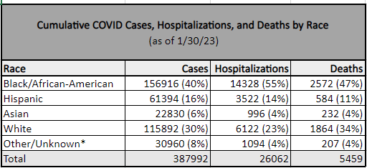
Cumulative Data: COVID-19 in the Asian Community (since March 2020)

Slide 4
The Pandemic is NOT Over *
In Philadelphia, the community level is Medium.
Currently, 16.8% of all PCR tests in Philadelphia are positive
Avg case rate for the past week: 91.2 per 100,000
Avg daily cases: 209
In February 2022, it was approximately twice that.
This does not count positive cases identified through home testing.
There are currently 231 COVID hospitalizations in Philadelphia
There were 16 deaths related to COVID in the prior week.
COVID-19 can be mild or severe and can also cause lasting health problems for people who have survived the illness. This is called “long COVID”.
*(https://www.phila.gov/programs/coronavirus-disease-2019-covid-19/updates/

Slide 5
Current Data: COVID-19 in the Asian Community
PCR Tests administered: 7.2 persons per 10,000 (1/22/23)
Infections: 4.3 per 10,000 (1/15/23)
Hospitalizations: .2 per 10,000 (1/1/23)
Deaths: .1 per 10,000 (12/25/22)
*(https://www.phila.gov/programs/coronavirus-disease-2019-covid-19/updates

Slide 6
What are Variants and Should We Care?
The virus is constantly changing and as new versions, or variants, emerge, it is possible to become reinfected.
XBB.1.5: 72.5% of cases
BQ.1.1: 14.6% of cases
BQ.1: 6.6% of cases
XBB: 2.8% of cases
CH1.1: 1.4% of cases
BN.1: 0.8% of cases
BA.5: 0.5% of cases
BF.7: 0.4% of cases
BA.5.2.6: 0.2% of cases
BF.11: 0.1% of cases
Studies show that you have some protection against new variants because of vaccines, even though the variants are different. They are still offspring of the original, omicron variant.

Slide 7
The Good News (but we can do better!)
Vaccines protect against severe disease, hospitalizations and death.
While you may still become infected, it is less likely that you will have serious consequences.
You are fully vaccinated when you have received:
2 doses of primary vaccine AND
1 dose of updated bivalent booster
In Philadelphia, 64% of population are vaccinated with the primary series, but only 13% have received the updated bivalent booster.
Among Asians in Philadelphia, only 14% have received the updated bivalent booster.
If you become infected, you can ask your doctor to prescribe an antiviral medication, Paxlovid, which needs to be taken within the first 5 days of illness.

Slide 8
Vaccines and Boosters
Primary care providers, health centers, and pharmacies will only offer the updated bivalent booster to all people 5 and older.
The original booster is no longer available.
Individuals 5 and older can get the booster if it has been:
at least 2 months after completion of the primary series, or
at least 2 months after receiving an original (monovalent) mRNA booster.
*For children aged 6 months–4 years who completed the Moderna primary series and if it has been at least 2 months since their last dose.

Slide 9
Moving On
We are going to have to learn to live with COVID, meaning it will be considered “endemic”.
We have learned to do this with other respiratory illnesses such as flu and RSV.
It is possible that we will need a yearly booster to maintain immunity, but unlike flu, there will be less guesswork about what the vaccine will contain (remember, the variants are related).
Long COVID
Some people have ongoing symptoms even after mild infection.
You are 50% less likely to have long COVID if you have been vaccinated.

Slide 10
How to Stay Safe
High risk? Wear a high-quality (e.g.,KN95) mask indoors in public.
Anyone may choose to mask at any time, especially when indoors.
Self-test before contact with high-risk people.
Stay up to date with COVID-19 vaccines, including the updated bivalent booster.
Ventilation in indoor spaces.
Avoid contact with people who have suspected or confirmed COVID-19.
Isolate if you think you have it or have tested positive.
Immunocompromised? Talk to your healthcare provider to protect yourself.

Slide 11
For More Information:
https://www.phila.gov/programs/coronavirus-disease-2019-covid-19/faq/
For information on health-related emergencies: https://hip.phila.gov/emergency-response/planning-for-emergencies/
If you need a copy of your shot record: bit.ly/philavaxrecordrequest
Call Center: 215-685-5488
email covid@phila.gov

Slide 12
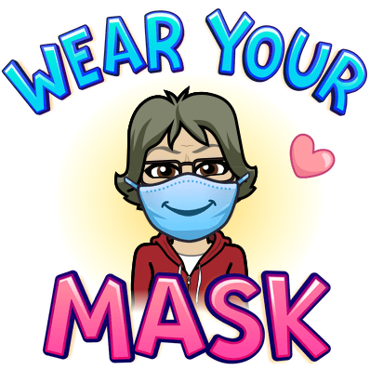
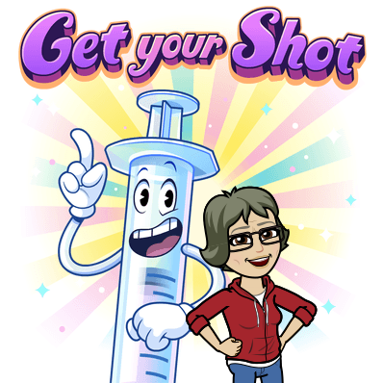
THANK YOU!!
QUESTIONS?

